Slide 1
Week 3-Lec 2
Transmission Control Protocol -Fundamentals

Slide 2

Transport layer: roadmap
Transport-layer services
Multiplexing and demultiplexing
Connectionless transport: UDP
Principles of reliable data transfer
Connection-oriented transport: TCP
Principles of congestion control
TCP congestion control
Evolution of transport-layer functionality

Slide 3



















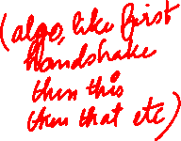
Transport services and protocols
application
transport
network
data link
physical
provide logical communication between application processes running on different hosts
mobile network
national or global ISP
transport protocols actions in end systems:
sender: breaks application messages into segments, passes to network layer
receiver: reassembles segments into messages, passes to application layer
logical end-end transport
local or regional ISP
home network
content
provider
network
application
transport
network
data link
physical
datacenter
network
two transport protocols available to Internet applications
TCP, UDP
enterprise
network
Notes:
By logical communication , we
mean that from an application’s perspective, it is as if the hosts running the processes
were directly connected; in reality, the hosts may be on opposite sides of the
planet, connected via numerous routers and a wide range of link types. Application
processes use the logical communication provided by the transport layer to send
messages to each other, free from the worry of the details of the physical infrastructure
used to carry these messages.
Let’s look at each of these three (logical communications, actions,

Slide 4
Transport Layer Actions
Sender:
application
application
is passed an application-layer message
app. msg
determines segment header fields values
T_{h}
transport
app. msg
transport
T_{h}
creates segment
network (IP)
network (IP)
passes segment to IP
link
link
physical
physical

Slide 5
Two principal Internet transport protocols
application
transport
network
data link
physical
TCP: Transmission Control Protocol
reliable, in-order delivery
congestion control
flow control
connection setup
UDP: User Datagram Protocol
unreliable, unordered delivery
no-frills extension of “best-effort” IP
services not available:
delay guarantees
bandwidth guarantees
mobile network
national or global ISP
logical end-end transport
local or regional ISP
home network
content
provider
network
application
transport
network
data link
physical
datacenter
network
enterprise
network

Slide 6
Transport Layer Actions
Receiver:
application
receives segment from IP
application
checks header values
transport
transport
app. msg
extracts application-layer message
network (IP)
network (IP)
demultiplexes message up to application via socket
link
link
physical
physical
app. msg
T_{h}

Slide 7
How demultiplexing works
host receives IP datagrams
each datagram has source IP address, destination IP address
each datagram carries one transport-layer segment
each segment has source, destination port number
host uses IP addresses & port numbers to direct segment to appropriate socket
32 bits
source port #
dest port #
other header fields
application
data
(payload)
TCP/UDP segment format

Slide 8

Connectionless demultiplexing
Recall:
when creating socket, must specify host-local port #:
DatagramSocket mySocket1 = new DatagramSocket(12534);
when receiving host receives UDP segment:
checks destination port # in segment
directs UDP segment to socket with that port #
when creating datagram to send into UDP socket, must specify
destination IP address
destination port #
IP/UDP datagrams with same dest. port #, but different source IP addresses and/or source port numbers will be directed to same socket at receiving host

Slide 9

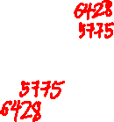
Connectionless demultiplexing: an example
DatagramSocket serverSocket = new DatagramSocket
(6428);
DatagramSocket mySocket2 = new DatagramSocket
(9157);
DatagramSocket mySocket1 = new DatagramSocket (5775);
application
application
P1
application
P3
P4
transport
transport
network
transport
network
link
network
link
physical
link
physical
physical
source port: 6428
dest port: 9157
source port: ?
dest port: ?
source port: 9157
dest port: 6428
source port: ?
dest port: ?

Slide 10
Connection-oriented demultiplexing
TCP socket identified by 4-tuple:
source IP address
source port number
dest IP address
dest port number
server may support many simultaneous TCP sockets:
each socket identified by its own 4-tuple
each socket associated with a different connecting client
demux: receiver uses all four values (4-tuple) to direct segment to appropriate socket

Slide 11
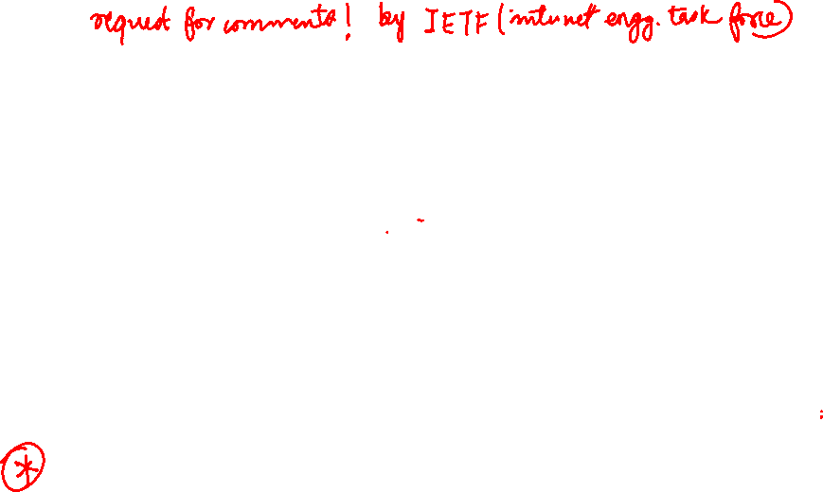
TCP: overview RFCs: 793,1122, 2018, 5681, 7323
point-to-point:
one sender, one receiver
reliable, in-order byte steam:
no “message boundaries"
full duplex data:
bi-directional data flow in same connection
MSS: maximum segment size
cumulative ACKs
pipelining:
TCP congestion and flow control set window size
connection-oriented:
handshaking (exchange of control messages) initializes sender, receiver state before data exchange
flow controlled:
sender will not overwhelm receiver
Notes:
Typical MSS is 1460 bytes

Slide 12
TCP segment structure
32 bits
source port #
dest port #
segment seq #: counting bytes of data into bytestream (not segments!)
ACK: seq # of next expected byte; A bit: this is an ACK
sequence number
acknowledgement number
length (of TCP header)
head
len
not
used
A
P
S
receive window
flow control: # bytes receiver willing to accept
C
E
U
R
F
Internet checksum
checksum
Urg data pointer
options (variable length)
C, E: congestion notification
TCP options
application
data
(variable length)
data sent by application into TCP socket
RST, SYN, FIN: connection management

Slide 13
TCP sequence numbers, ACKs
outgoing segment from sender
Sequence numbers:
byte stream “number” of first byte in segment’s data
source port #
dest port #
sequence number
acknowledgement number
rwnd
checksum
urg pointer
window size
N
Acknowledgements:
seq # of next byte expected from other side
cumulative ACK
sender sequence number space
sent
ACKed
sent, not-yet ACKed
(“in-flight”)
usable
but not
yet sent
not
usable
outgoing segment from receiver
source port #
dest port #
sequence number
acknowledgement number
A
rwnd
checksum
urg pointer

Slide 14
TCP sequence numbers, ACKs
Host A
Host B
User types‘C’
Seq=42, ACK=79, data = ‘C’
host ACKs receipt of‘C’, echoes back ‘C’
Seq=79, ACK=43, data = ‘C’
host ACKs receipt of echoed ‘C’
Seq=43, ACK=80
simple telnet scenario
Notes:
The key thing to note here is that the ACK number (43) on the B-to-A segment is one more than the sequence number (42) on the A-toB segment that triggered that ACK
Similarly, the ACK number (80) on the last A-to-B segment is one more than the sequence number (79) on the B-to-A segment that triggered that ACK

Slide 15
TCP connection management
before exchanging data, sender/receiver “handshake”:
agree to establish connection (each knowing the other willing to establish connection)
agree on connection parameters (e.g., starting seq #s)
application
application
connection state: ESTAB
connection variables:
seq # client-to-server
server-to-client
rcvBuffer size
at server,client
connection state: ESTAB
connection Variables:
seq # client-to-server
server-to-client
rcvBuffer size
at server,client
network
network
Socket clientSocket =
newSocket("hostname","port number");
Socket connectionSocket = welcomeSocket.accept();
Notes:
The other TCP topic we’ll want to consider here is that of “connection management”
The TCP sender and reciver have a number of pieces of shared state that they must establish before actually communication
FIRST theym ust both agree that they WANT to communicate with each other
Secondly there are connection parameters – the initial sequence number and the initial receiver-advertised bufferspace that they’ll want to agree on
This is done via a so-called handshake protocol – the client reaching our to the server, and the server answering back.
And before diving into the TCP handshake protocol, let’s first consider the problem of handshaking, of establishing shared state.

Slide 16
TCP 3-way handshake
Server state
Client state
serverSocket = socket(AF_INET,SOCK_STREAM)
serverSocket.bind((‘’,serverPort))
serverSocket.listen(1)
connectionSocket, addr = serverSocket.accept()
clientSocket = socket(AF_INET, SOCK_STREAM)
LISTEN
clientSocket.connect((serverName,serverPort))
LISTEN
choose init seq num, x
send TCP SYN msg
SYNSENT
SYNbit=1, Seq=x
choose init seq num, y
send TCP SYNACK
msg, acking SYN
SYN RCVD
SYNbit=1, Seq=y
ACKbit=1; ACKnum=x+1
received SYNACK(x)
indicates server is live;
send ACK for SYNACK;
this segment may contain
client-to-server data
ESTAB
ACKbit=1, ACKnum=y+1
received ACK(y)
indicates client is live
ESTAB
Notes:
TCP’s three way handshake, that operates as follows
Let’s say the client and server both create a TCP socket as we learned about in Chapter 2 and enter the LISTEN state
The client then connects to the server sending a SYN message with a sequence number x (SYN Message is an TCP Segment with SYN but set in the header – you might want to go back and review the TCP segment format!)
The server is waiting for a connection, and receives the SYN message enters the SYN received state (NOT the established state and sends a SYN ACK message back.
Finally the client sends an ACK message to the server, and when the server receiver this enters the ESTABLished state. This is when the application process would see the return from the wait on the socket accept() call

Slide 17
Closing a TCP connection
client, server each close their side of connection
send TCP segment with FIN bit = 1
respond to received FIN with ACK
on receiving FIN, ACK can be combined with own FIN
simultaneous FIN exchanges can be handled
Notes:
All good things must come to an end, and that’s true for a TCP connection as well.
And of course there’s a protocol for one side to gracefully close of a TCP connection using a FIN message, to which the other side sends a FINACK message and waits around a bit to respond to any retransmitted FIN messages before timing out.

Slide 18
Principles of reliable data transfer
sending process
receiving process
application
data
data
transport
reliable channel
reliable service abstraction
Notes:
note arrows through reliable data transfer channel is just one way – reliably send from sender to receiver

Slide 19
Principles of reliable data transfer
sending process
receiving process
sending process
receiving process
application
data
data
application
data
data
transport
transport
reliable channel
sender-side of
reliable data transfer protocol
receiver-side
of reliable data transfer protocol
reliable service abstraction
transport
network
unreliable channel
reliable service implementation
Notes:
Spend some time talking about how its to the sender and receiver side protocol that IMPLEMENTS reliable data transfer
Communication over unreliable channel is TWO-way: sender and receiver will exchange messages back and forth to IMPLEMENT one-way reliable data transfer

Slide 20
Principles of reliable data transfer
sending process
receiving process
application
data
data
transport
sender-side of
reliable data transfer protocol
receiver-side
of reliable data transfer protocol
Complexity of reliable data transfer protocol will depend (strongly) on characteristics of unreliable channel (lose, corrupt, reorder data?)
transport
network
unreliable channel
reliable service implementation
Notes:
So we have a sender side and a receiver side. How much work they’ll have to do depends on the IMPAIRMENTS introduced by channel – if the channel is perfect – no problem!

Slide 21
Reliable data transfer protocol (rdt): interfaces
rdt_send(): called from above, (e.g., by app.). Passed data to deliver to receiver upper layer
deliver_data(): called by rdt to deliver data to upper layer
sending process
receiving process
rdt_send()
data
data
deliver_data()
data
sender-side
implementation of rdt reliable data transfer protocol
receiver-side
implementation of rdt reliable data transfer protocol
packet
udt_send()
Header
data
Header
data
rdt_rcv()
unreliable channel
udt_send(): called by rdt
to transfer packet over
unreliable channel to receiver
rdt_rcv(): called when packet arrives on receiver side of channel
Bi-directional communication over unreliable channel

Slide 22

Reliable data transfer in action
sender
receiver
sender
receiver
send pkt0
pkt0
send pkt0
pkt0
rcv pkt0
rcv pkt0
ack0
send ack0
ack0
send ack0
rcv ack0
rcv ack0
send pkt1
pkt1
send pkt1
pkt1
rcv pkt1
X
ack1
send ack1
loss
rcv ack1
send pkt0
pkt0
rcv pkt0
timeout
resend pkt1
ack0
send ack0
pkt1
rcv pkt1
ack1
send ack1
rcv ack1
send pkt0
pkt0
(a) no loss
rcv pkt0
ack0
send ack0
(b) packet loss

Slide 23
Reliable data transfer in action
sender
receiver
sender
receiver
send pkt0
pkt0
rcv pkt0
send pkt0
pkt0
send ack0
rcv pkt0
rcv ack0
ack0
ack0
send ack0
send pkt1
pkt1
rcv ack0
rcv pkt1
send pkt1
pkt1
send ack1
rcv pkt1
ack1
ack1
send ack1
X
timeout
resend pkt1
loss
pkt1
rcv pkt1
timeout
resend pkt1
rcv ack1
(detect duplicate)
pkt1
rcv pkt1
send ack1
send pkt0
pkt0
ack1
(detect duplicate)
rcv pkt0
rcv ack1
send ack1
rcv ack1
ack1
ack0
send ack0
send pkt0
pkt0
(ignore)
rcv pkt0
ack0
send ack0
pkt1
(c) ACK loss
(d) premature timeout/ delayed ACK

Slide 24
channels with errors and loss
New channel assumption: underlying channel can also lose packets (data, ACKs)
checksum, sequence #s, ACKs, retransmissions will be of help … but not quite enough
Q: How do humans handle lost sender-to-receiver words in conversation?

Slide 25

channels with errors and loss
Approach: sender waits “reasonable” amount of time for ACK
retransmits if no ACK received in this time
if pkt (or ACK) just delayed (not lost):
retransmission will be duplicate, but seq #s already handles this!
receiver must specify seq # of packet being ACKed
use countdown timer to interrupt after “reasonable” amount of time
timeout

Slide 26
stop-and-wait operation
sender
receiver
first packet bit transmitted, t = 0
first packet bit arrives
RTT
last packet bit arrives, send ACK
ACK arrives, send next
packet, t = RTT + L / R
example: 1 Gbps link, 15 ms prop. delay, 8000 bit packet
time to transmit packet into channel:
L
8000 bits
D_{trans} =
=
=
8 microsecs
R
10⁹ bits/sec

Slide 27
stop-and-wait operation
sender
receiver
L / R
=
L/R
U_{sender}
RTT
+ L / R
.008
RTT
=
30.008
=
0.00027
Throughput = ???

